Slide 1
Introduction to Electrical Circuit Lab

Slide 2
Course Teachers’
মোঃ সাফিউল ইসলাম
Lecturer
Dept. of EEE
Khadijatul Kubra
Lecturer
Dept. of EEE
Welcome to KUET and Circuit lab at EEE dept.

Slide 3
Do’s and Don’ts

Slide 4
Keep your smart phone in silent mode to make you smart in the lab or class

Slide 5
Be punctual, truthful and honest

Slide 6
Manage yourself to come to the lab at 10:40 am Sharp

Slide 7
Always tell the truth. Share your hurdles with your teachers and friends

Slide 8
Set up your mind to work together with your groupmates in the lab

Slide 9
Try and Understand and if you can’t understand then feel free to ask your respective teacher

Slide 10
Show honor and respect to each other and also to the lab attendant

Slide 11
Work safely

Slide 12
Try and Understand to write your own reports

Slide 13
So now move on to Don’t s
Let’s start

Slide 14
Don’t try to dominate Don’t make too much noise Be gentle with the lab equipment's

Slide 15
Work safely other wise? 😒

Slide 17
Okay, Lets explore

Slide 18
Attendance 10% Lab Reports and Class Performance 50% Quizzes 20% Central Viva 20% Total 100%
Marks Distribution and Evaluation

Slide 19
Familiarization with some electric meters and equipments and measurement of AC and DC voltages and currents
Experiment No. 1

Slide 20
Circuit: A close conducting path through which an electric current either flows or intended to flow
Electrical Parameters: The various elements of an electric circuit are called its parameter, like resistor, inductor, capacitor, voltage source, current source etc.
Active Elements: Voltage source, Current source
Passive Elements: Resistors, Inductors, Capacitors

Slide 21
Active Elements
Voltage Source :A voltage source is a two terminal device which can maintain a fixed voltage.
Current Source:A current source is an electronic circuit that delivers or absorbs an electric current which is independent of the voltage across it. i.e. which can deliver a constant current.

Slide 22
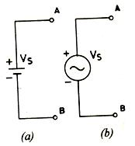
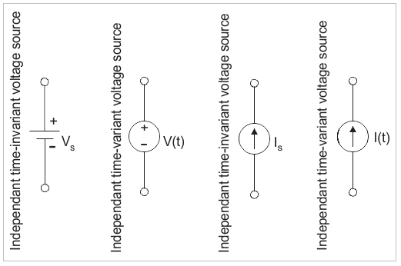
Active Elements

Slide 23
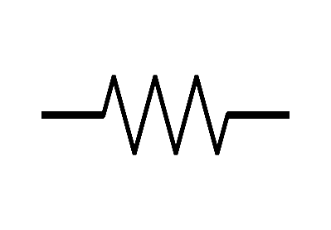
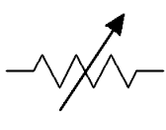
Passive Elements
Resistor:
Ex: Incandescent Bulb, Variable Resistor
Rating: Resistance, Tolerance, Power ratings
Resistor Variable resistor(Rheostat)

Slide 24
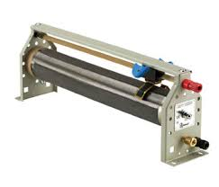
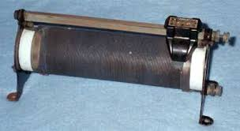
Passive Elements (Resistor)

Slide 25
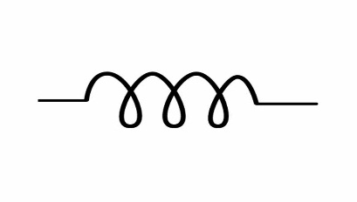
Passive Elements
Inductor:
Ex: Ballast or Choke
Rating: Inductance, Current ratings
Symbol of Inductor

Slide 26
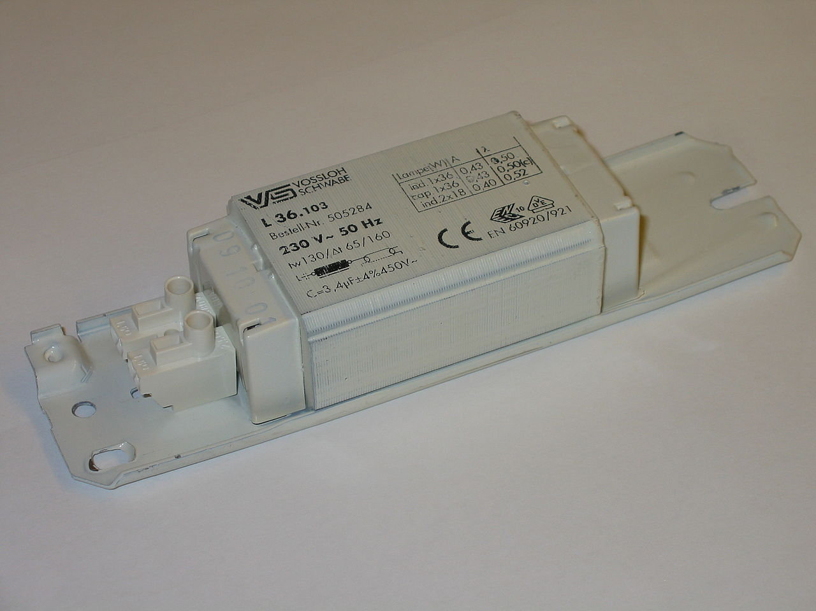
Passive Elements (Inductor)

Slide 27
Passive Elements
Capacitor:
Ex: Capacitor Bank
Rating: Capacitance, Voltage ratings
Capacitor Variable capacitor (Rheostat)

Slide 28
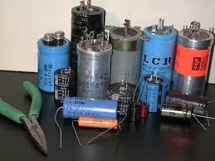
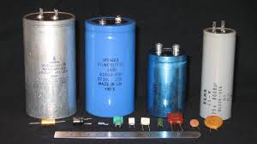
Passive Elements (Capacitor)

Slide 29
Electric Meters

Slide 30
Electric Meter
Different Electric meters for measurement purpose
Ammeters (AC and DC)
Voltmeters (AC and DC)
AVO meter (Commercially called multimeter)
Wattmeter

Slide 31
Ammeter ( Amp + meter)
A current measuring instrument
Measure the ammount of current flow through the circuit
Has low internal resistance (ideally low)
Ammeter is always connected in series with the branch whose current is to be measured

Slide 32
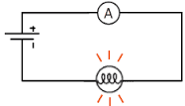
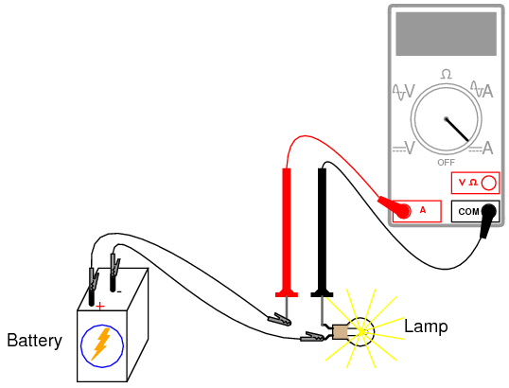
Connection of Ammeter

Slide 33
Types of Ammeter
Two types (since we have both AC and DC supply)
DC Ammeter
AC Ammeter
A DC ammeter is polarity marked with +Ve and –Ve sign
The +Ve polarity of the DC ammeter have to be connected to the current enter ing side

Slide 34
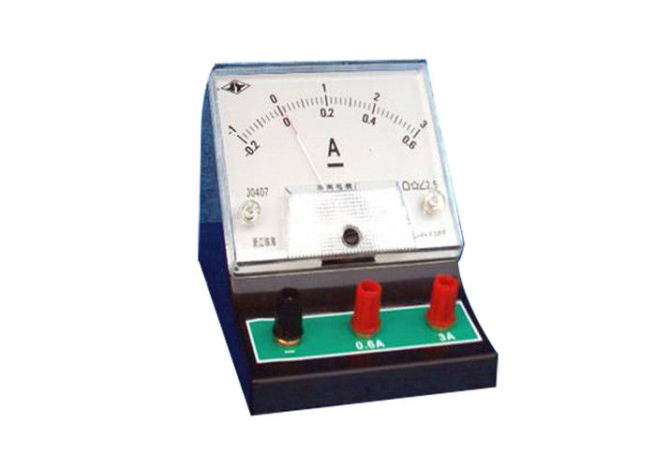
DC Ammeter
The straight line
under A Indicates
DC Ammeter
Range Extension

Slide 35
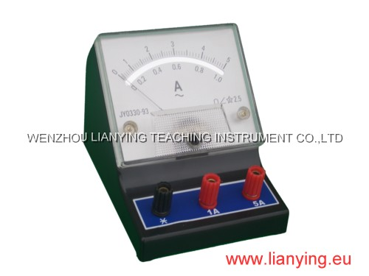
AC Ammeter
This sinusoidal mark
Indicates AC ammeter

Slide 36
Do You Feel Bored?
Okay Let’s Have some gossip
😉

Slide 37
Voltmeter ( Volt + meter)
Measures the electrical potential difference between two points in a electric circuit
Has high internal resistance (ideally infinite)
Ammeter is always connected in paralle (across) with the load

Slide 38
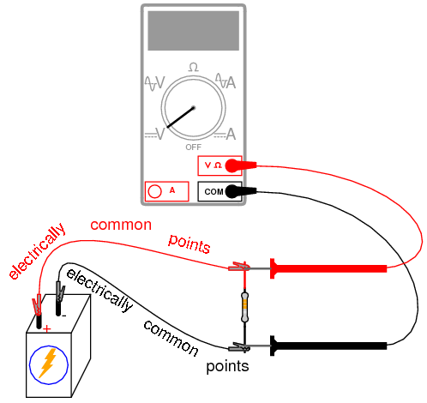
Connection of Voltmeter

Slide 39
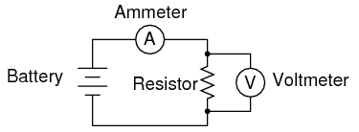
Connection of Ammeter and Voltmeter

Slide 40
Types of Voltmeter
Two types (since we have both ac and dc supply)
DC Voltmeter
AC Voltmeter
A DC voltmeter’s terminals are polarity marked with +Ve and –Ve sign
AC Meters don’t have such polarity marking

Slide 41
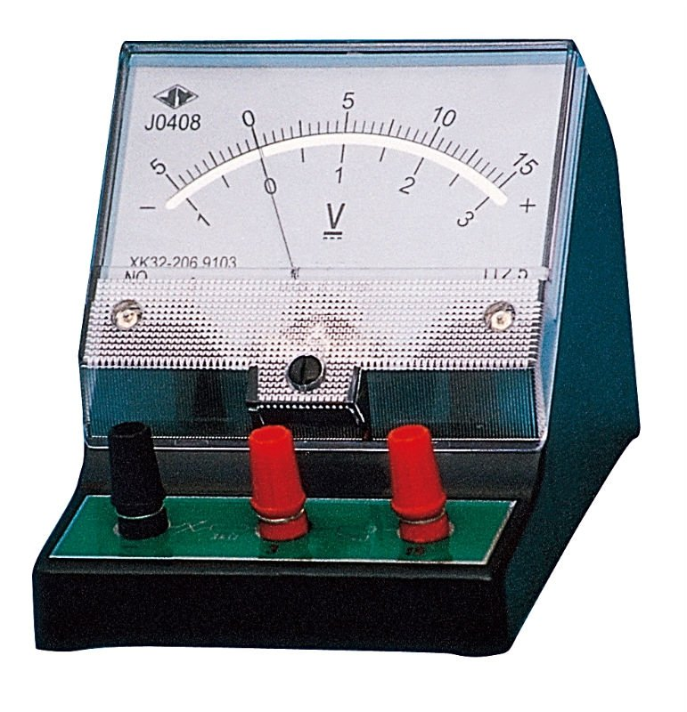
DC Voltmeter
This marks
Indicates DC
voltmeter

Slide 42
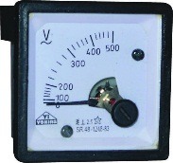
AC Voltmeter
This sinusoidal
marks
indicates AC
voltmeter

Slide 43
Multimeter
It is also known as Electronic VOM or AVO meter
Used to measure current, voltage and resistance both for AC and DC quantity, for a number of ranges
Some multimeter provide the facilities of measuring inductance, capacitance, temperature
Two type _ Analog AVO meter
_ Digital AVO meter

Slide 44
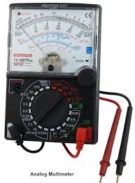
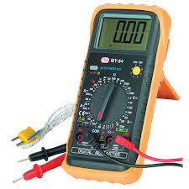
Multimeter
Analog Multimeter
Digital Multimeter

Slide 45
Wattmeter
Measure electric power in a circuit
It has generally two coils and each coil has two terminal (so it has four terminal)
One coil is called Current coil (C.C)
Another coil is called Potential coil (P.C)

Slide 46
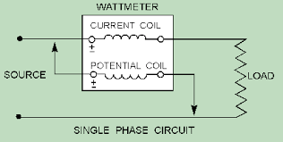
Wattmeter
Current coil (C.C) measures current
Potential coil (P.C) measures the potential difference across the load

Slide 47
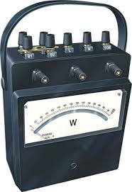
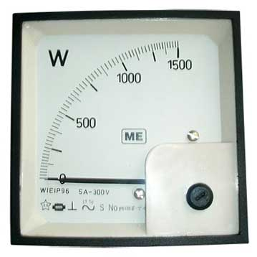
Wattmeter

Slide 48
Report Writing

Slide 49
How to Write a Good Report?

Slide 50
A Good Report Contains Following Parts
Objectives
Introduction (Including Theoretical background)
Apparatus Required
Experimental Setup or Circuit Diagram
Experimental Data
Calculation
Graphs or Vector Diagram (if any)
Results and Discussion
Conclusion
Question & Answer
Bibliography

Slide 51
Report Writing
Objectives
Main puposes of the experiments have to be done.
Should be mentioned in points
Introduction
Introductory description and working principle of the experiments have to be note down
Apparatus or components required
Equipments, components and measuring instruments used in the experiemts have to write down in a tabular form with rating and quantity

Slide 52
Report Writing
Experimental Setup
Circuit diagram of the experiment with all necessary electrical sign.
Name of the figure must be mentioned. Example: Fig. (2.1): Pictorial view of ammeter
Experimental data
Should be written in table.
To draw all the figures and the tables must use pencil
Calculation
Elaborate calculation of the whole work

Slide 53
Report Writing
Graphical representation
Proper Scaling of axis.
Encircle the plotted data points.
Labeling (Units should be included).
Figure No along with figure name should be mentioned.
Results and Discussion
Most important part of a report.
Discuss your results
Mention numerical values (if any).
Compare the physically measured results with the theoretically calculated results.
If there is deviation between these results, then mention the scientific reasons for this deviation.
Give the description of graphical representation (if any) on the basis of theoretical background.

Slide 54
Report Writing
Conclusion
Mention what are the learnings from this experiment.
Note down the advantages of this experiment in practical field.
Questions and Answer
Questions given at the end of each experiment, must be written with appropriate answer
(if any)
Bibliography
Sources (Books, Journal etc.) , you have used to write the report, have to be mentioned

Slide 55
THANKS!
Any questions?
😉

Slide 56
Free templates for all your presentation needs
For PowerPoint and Google Slides
100% free for personal or commercial use
Ready to use, professional and customizable
Blow your audience away with attractive visuals

