Slide 1
Course code : EEE-4123
High Voltage Engineering
Lecture-06
Topics
High Voltage Direct current (HVDC)
Presented by
Md. Shamim Sarker
Assistant Professor
Dept. of EEE, KUET

Slide 2
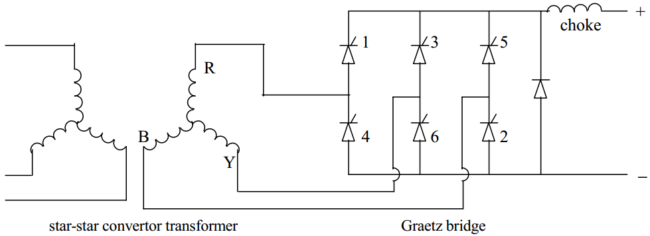
Converter Arrangement and Operation
n
Figure: 6 Pulse bridge converter

Slide 3
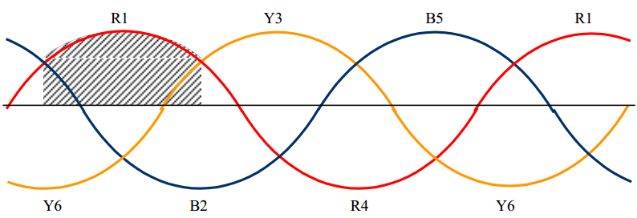
n

Slide 4
Equation of voltage in each phase
Solving for DC Voltage, we get

Slide 5
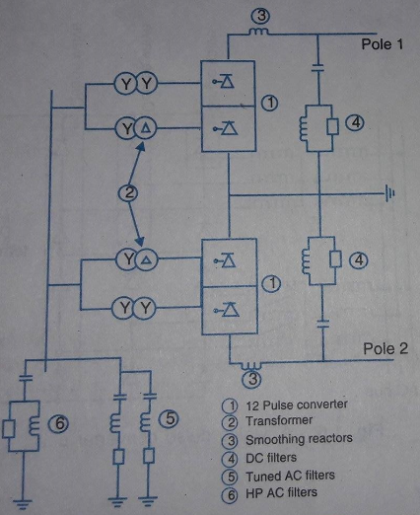
Converter Station
Conversion from AC to DC or from DC to AC take place
Figure: Schematic diagram of typical HVDC converter station

Slide 6
Converter Station
Components of converter stations:
Converter Station:
→ Two three phase converter bridge connected in series
→ Total 12 valves are required
→ Valves can be packeged as single, double or quadrivalve
→ Valve firing signal is generated at the converter control at ground potential

Slide 7
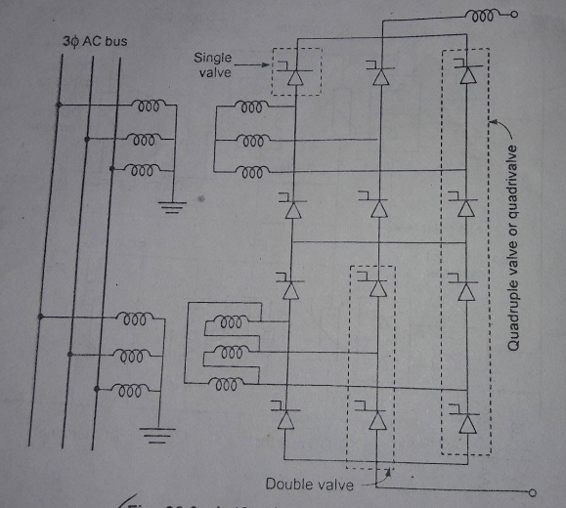
Figure: Twelve Pulse converter unit

Slide 8
Converter Station
Components of converter stations:
2. Converter Transformer:
→ Supply Power from AC network to DC network
→ Valve side winding is converter bridge(One in star; Another is in delta)
→ AC side windings of both are connected in star with their neutral ground

Slide 9
Converter Station
Components of converter stations:
3. Filters:
→ AC Filters: Passive circuit provides to bypass AC harmonics. Connected between phase and earth. Provide reactive power for converter.
→ DC Filters : Connected between pole bus and neutral bus. Do not provide reactive power
→High frequency filter: Bypass radio frequency component

Slide 10
Converter Station
Components of converter stations:
4. Smoothing reactor: Large series reactor, used on DC side to smooth the dc current.
5. Reactive power source: Provide reactive power for the converter unit. We can use shunt capacitor for this.
6. Pole: path of DC which have the same polarity.
7. Ground Electrode: The ground electrodes are usually located at a distance of 15-55 km from the station

Slide 11
Back to back HVDC station

Slide 12
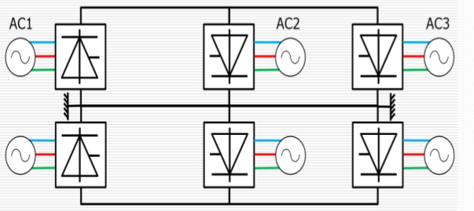
Two and Multi-terminal Converter station
2-TDC system
MTDC system
Advantages and Application of MTDC System

Slide 13
Limitation of HVDC system
Transformers.
Cost of converter stations
Circuit breakers
Generation of harmonics
Cooling of HVDC substation
HVDC system control

