Slide 1
Fixture

Slide 2
Special Bushings
Used for special operations.
Problem: Case-1: Two or more holes may be so close together that it is impossible to have an individual standard bushings for each hole.
Solution:
Standard thin wall bushings may be used.
Use a standard bushing containing two holes.

Slide 3
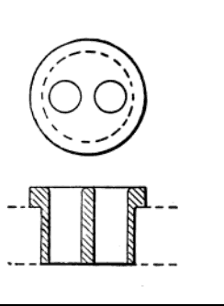
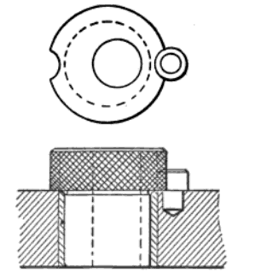
Fig: B(two holes in one bushing)
Fig : C (eccentric bushings)

Slide 4
c. One hole may be placed in an eccentric bushing.
d. Two standard bushings are sometimes modified for close hole drilling.
Problem: Case -2: When the busing is also required to hold the work piece as well as guide the drill
Solution: Screw bushing should be used.

Slide 5
FIXTURE
A fixture is a device for holding a work piece during machining operations. A fixture is always fastened to a machine or bench in a fixed position. It does not contain special arrangements for guiding the cutting tool as drill jigs do.

Slide 6
Types of fixture
Different types of fixtures are-
Vise fixture
Milling fixture
Boring fixture
Broaching fixture
Lathe fixture and
Grinding fixture

Slide 7
VISE FIXTURES
Standard machine vises adapted with special jaws provide an easy way of holding parts for machining.
Special jaws are designed to hold work pieces with irregular contours properly and at the same time avoiding damaging important surfaces

Slide 8
SPECIAL VISE JAWS

Slide 9
In figure ,
Shown a simple pair of jaws for holding a round work piece.
Pair of jaws for holding a thin sheet of nonmagnetic material.
Extended jaws for large work pieces . The guide pins are for securing alignment.
The tongue and groove assure accurate alignment.
Wedge type jaws necessary to hold the work piece firm against pressure in all directions.
The link construction is used where the pressure exerted by the cutting tools is likely to cause one end of the work piece to tilt upward.

Slide 10
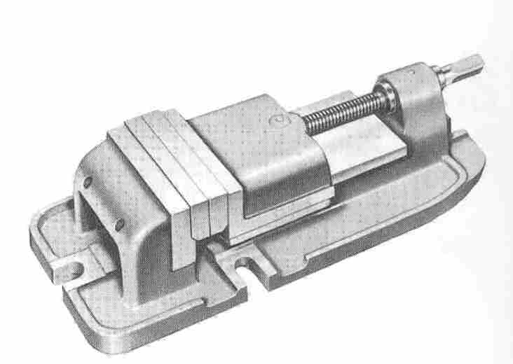
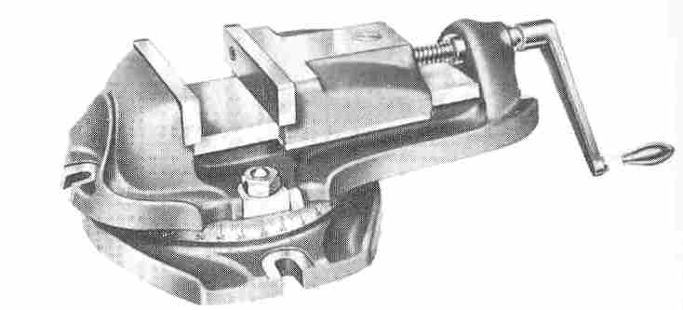
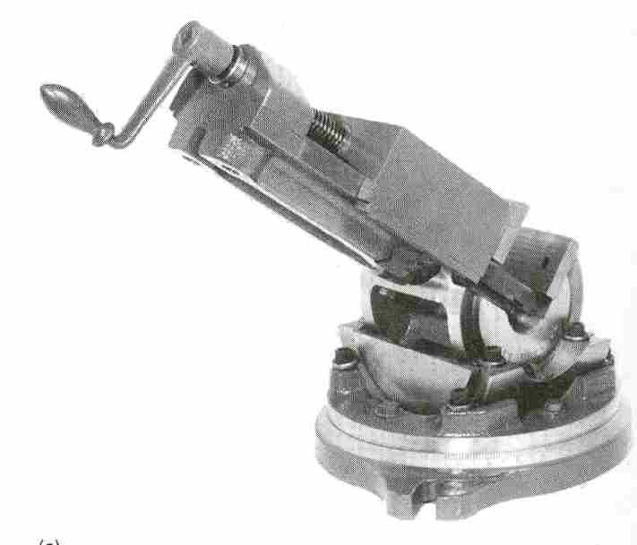
MILLING MACHINE VISES

Slide 11
Milling fixture
Methods of producing Milling:
Single piece milling
String milling
Reciprocal milling
Progressive milling
Index milling
Rotary milling

Slide 12
Types of milling fixture(Classification):
According to the type of milling operation performed on the work-piece
Face milling fixture
Slab milling fixture
Slotting milling fixture etc.
According to the way the work-piece is clamped
Hand clamping fixtures
Power clamping fixtures
Toggle fixtures
Automatic fixtures

Slide 13
According to the way of locating
Centre fixture
V block fixture
Pin or Stud fixture
According to the method of presenting the work-piece to the cutter
Craddle fixture
Rotary fixture
Drum fixture
Indexing fixture
Rise & Fall fixture
Special fixtures:
Magnetic fixtures
Vacuum fixtures

Slide 14
Lathe fixture
Necessity to manufacture special work holding fixtures in lathe:
A large majority of lathe operations can be accomplished by using standard chucks and holding methods . However many parts such as castings and forging can not readily be mounted by any of the standard methods . It is therefore necessary to manufacture special work holding fixtures for machining these parts.
The basic principles of fixture design apply to lathe fixtures. However there are additional considerations that apply specifically to lathe fixtures since the fixture and the work piece revolve. They are as follows –

Slide 15
Special design Considerations for lathe fixture
/Considerations that apply specifically to lathe fixtures
1.Clamps and other holding devices should be designed in such a way that they will not be loosened by centrifugal force.
2.The work piece should be gripped on its largest diameter.
3.The fixture should be well balanced to prevent vibration. Counterweights should be used for irregular shaped work piece.
4.The fixture should be as light weighted as possible since it is rotating.
5.Projections and sharp corners should be avoided as the operator may not be able to see them while the tool is rotating.
6.Thin sections of the work piece may require support to resist the pressure of the lathe tool.

Slide 16
Classification
Chucks
Faceplate fixtures
Mandrels
Magnetic & Vacuum chucks

Slide 17
Chuck
A chuck is a specialized type of clamp used to hold an object, usually an object with radial symmetry , especially a cylindrical object. It is most commonly used to hold a rotating tool or a rotating work piece.

Slide 18
Types of chucks
1.Universal self-centering scroll chucks with two, three , four and six jaws.
2.Independent four jaw chucks (used for odd shaped work piece .
3. Special top jaws chuck .
4.Rocking jaws on three-jaw chucks helps to ensure a secure grip on the part regardless of the surface roughness in the gripping area.
a) Horizontal
b) Vertical
Out of the three jaws only one is made rocking.

Slide 19
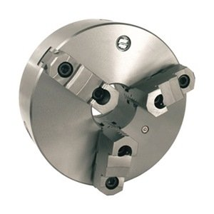
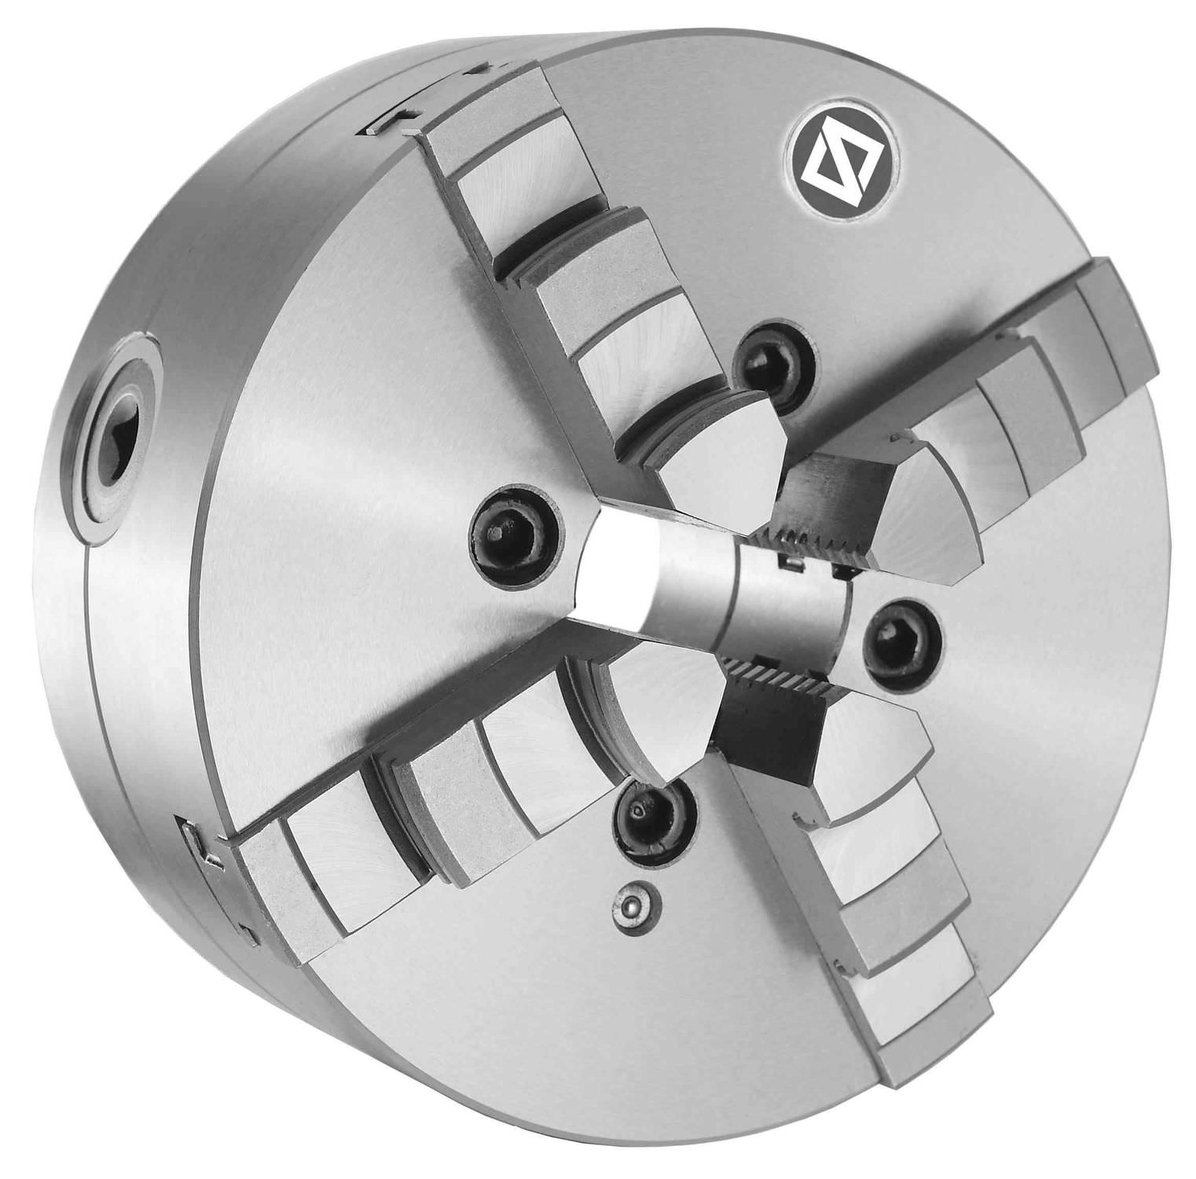
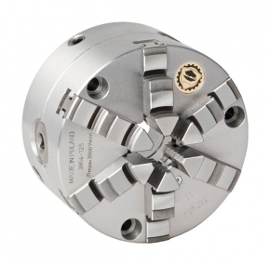
Types of chucks
1.Universal self-centering scroll chucks with two, three , four and six jaws.

Slide 20
Three-jaw Universal Chucks:
Three-jaw chucks used for circular and hexagonal work
Three-jaw chucks are usually self-centering
Three jaws move simultaneously when adjusted
This simultaneous movement is caused by a scroll plate into which all three jaws fit
They are usually provided with two set of jaws, one for outside chucking and the other for inside chucking

Slide 21
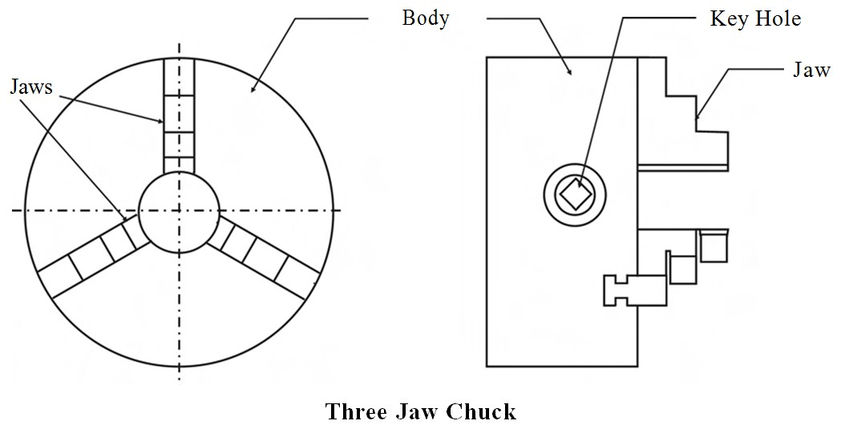
Fig: Universal self-centering scroll chucks with three jaws.

Slide 22
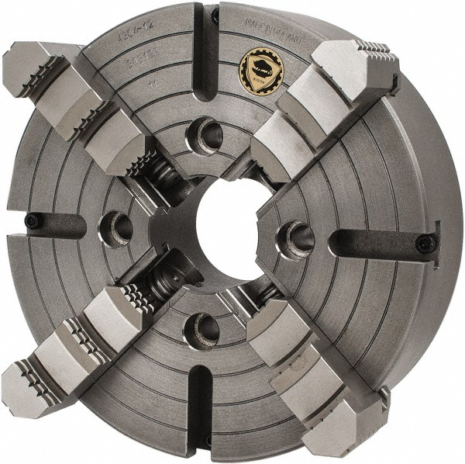
2.Independent four jaw chucks (for odd shaped work piece )

Slide 23
Four-jaw Independent Chucks:
4-jaw chucks are usually non-self-centering
Each jaw can be moved independently
Ideal for gripping round, square, hexagonal and irregularly shaped work pieces.
The jaws can be reversed to hold work by inside diameter
Multi-jaw chucks (6 or 8 jaws) for special purpose and high standards of accuracy

Slide 24
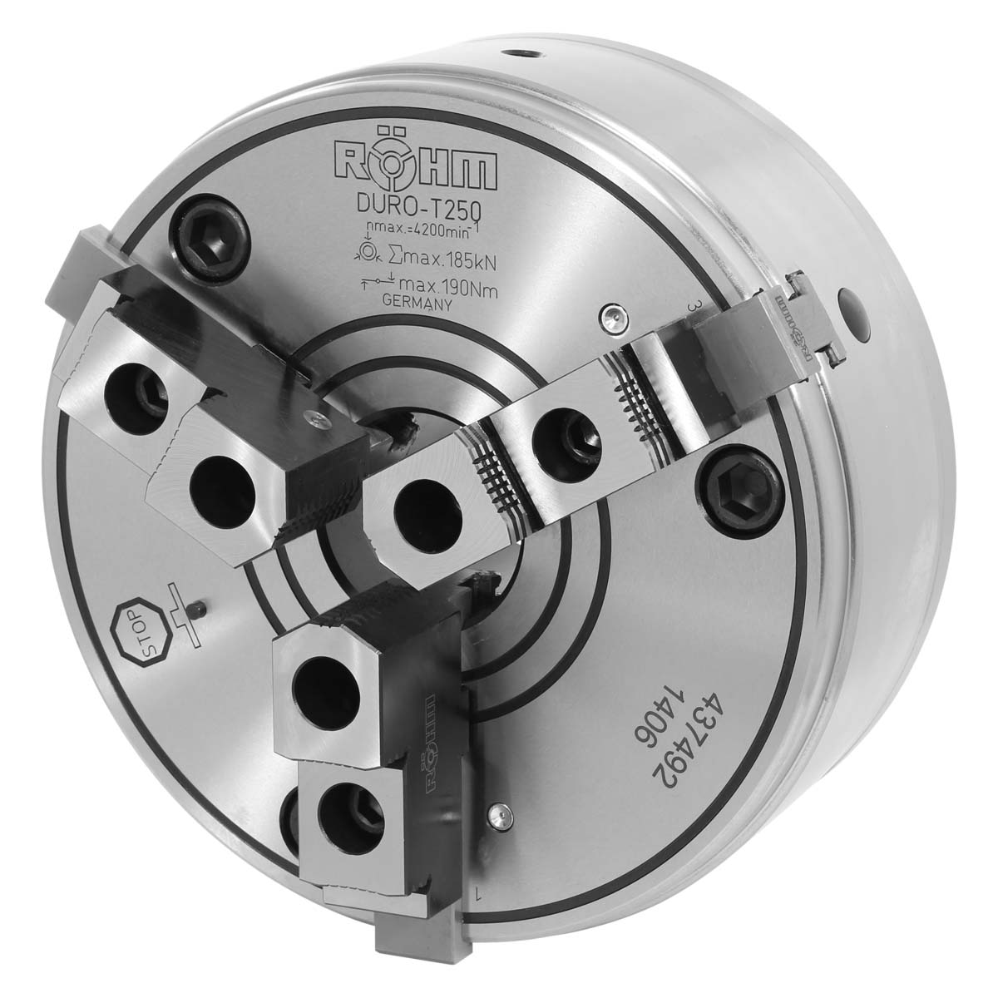
3. Special top jaws chuck

Slide 25
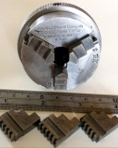
4.Rocking jaws on three-jaw chucks to secure the w/p properly regardless of the surface roughness .
a) Horizontal
b) Vertical
Out of the three jaws only one is made rocking.

Slide 26
Faceplates:
Faceplate fixture will rotate with work piece.
Circular metal plate fixed to the end of spindle
Used to hold work that is too large or of such a shape that it cannot be held in a chuck or between centers
It has slots or threaded holes
Work piece is clamped using T-nuts in the slots or threaded holes

Slide 27
Faceplate fixture types:
Types:
With counter weight
Without counter weight
With counterweights can also divided into:
1.Fixed counter weight type.
2. Adjustable counter weight type.
Counter weight/ counter poises are used to dynamically balance the faceplate fixtures.

Slide 28
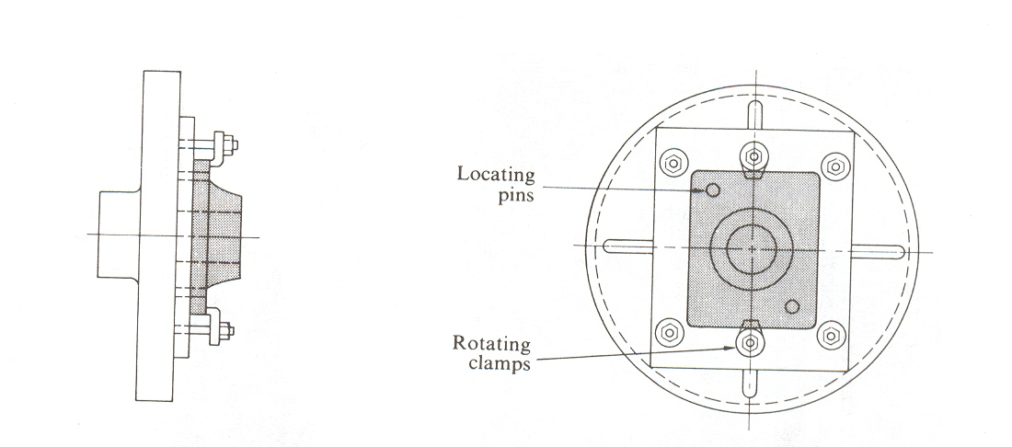
Faceplate fixtures Are fixed with standard faceplate and the work-piece is mounted on the fixture.
Fig: Simple faceplate fixture/Simple faceplate fixture without counterweight.

Slide 29
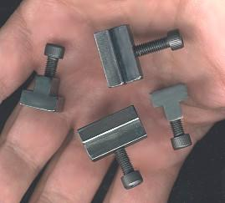
FACEPLATE AND T-NUTS

Slide 30
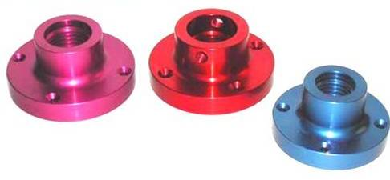
FACEPLATES

Slide 31
LATHE FIXTURES(Cont,d)
Magnetic Chucks:
It has the advantage of holding iron or steel parts that are too thin or that may be damaged if held in a conventional chuck.
Commercially available item.
Suitable only for light operations.
Suitable for thin walled light work piece.
A magnetic chuck consists of an accurately centered permanent magnet face.

Slide 32
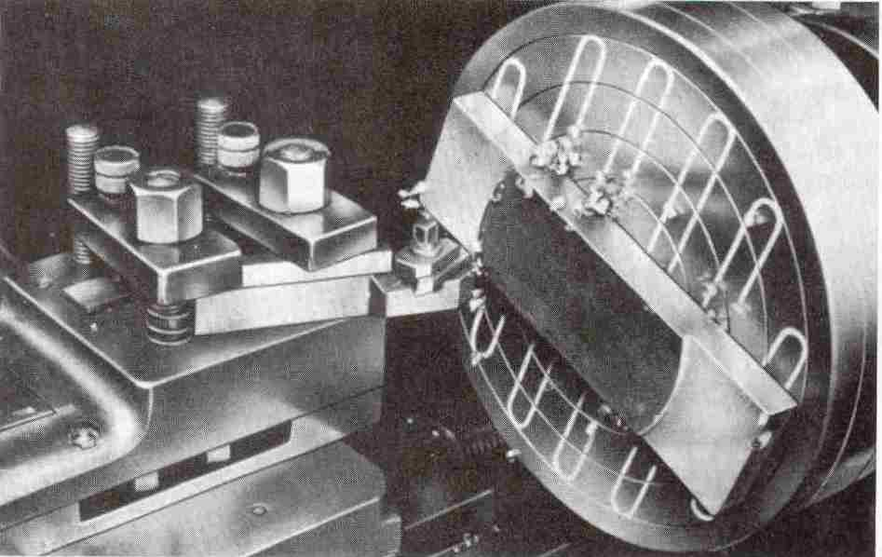
MAGNETIC CHUCKS
Magnetic or vacuum chucks are the commercial item available in market used to hold thin wall parts.

Slide 33
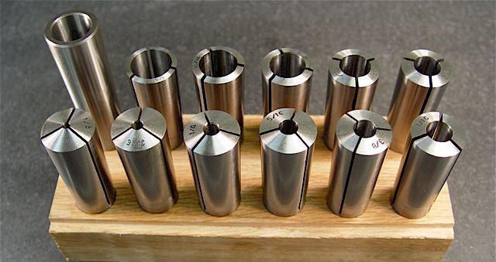
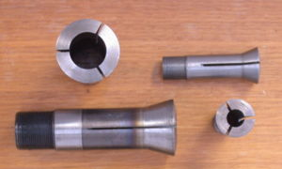
LATHE FIXTURES(Cont,d)
Collet Chucks:
That forms a collar around the object to be held and exerts a strong clamping force on the object when it is tightened.
A external collet is a sleeve with a (normally) cylindrical inner surface and a conical outer surface
Used for very small parts

Slide 34
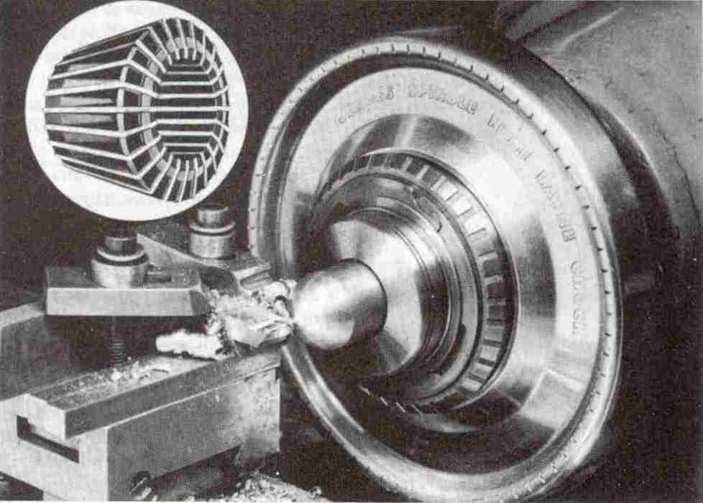
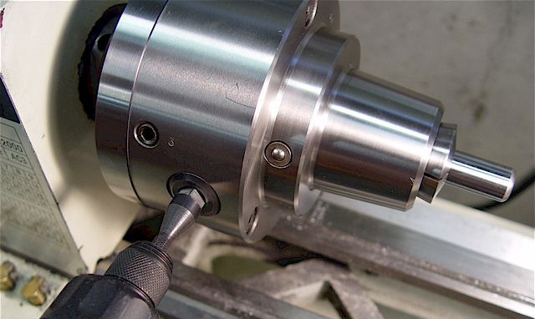
LATHE FIXTURES
Collet Chucks:

Slide 35
LATHE FIXTURES(Cont,d)
Mandrels:
Mandrels are internal locators used for machining of the outside diameter of the work piece concentric with finished bores.
Mandrels are shafts specially made to hold work to be machined concentrically around a previously bored or drilled hole
There are two general types, plain and expanding

Slide 36
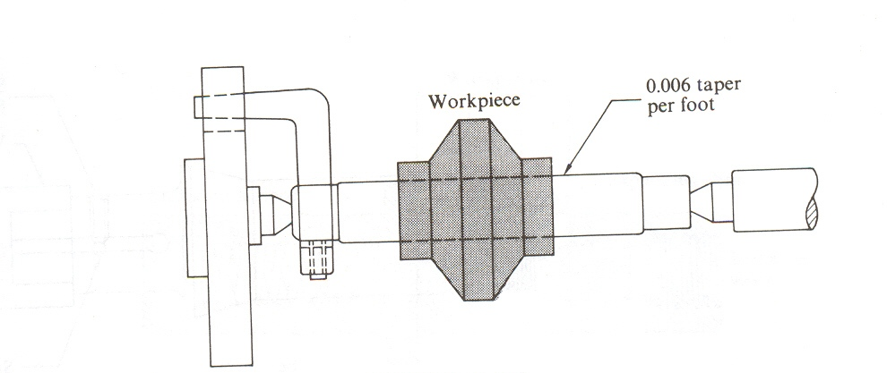
Plain Mandrels:
Plain mandrels have a 0.006-in. taper per foot.
There must be a mandrel for each hole size.
Not suitable for mass production.

Slide 37
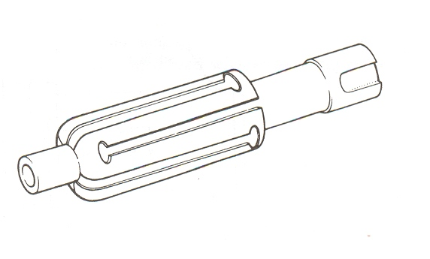
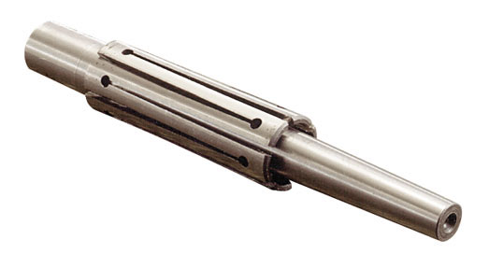
Sleeve-type Expanding Mandrels:
It is used for high degree of concentricity.
It provides the adjustment of locating diameter to suite the variation in the bore size of the work piece.

Slide 38
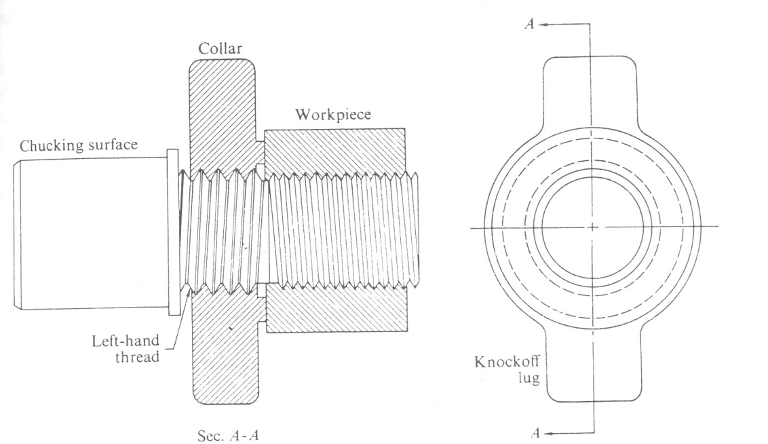
Mandrel for Threaded Parts:
Used for holding previously threaded work piece or work piece with internal threads

