Slide 1
Course code : EEE-4123
High Voltage Engineering
Lecture-05
Topics
Insulation: High Voltage Direct current (HVDC)
Presented by
Md. Shamim Sarker
Assistant Professor
Dept. of EEE, KUET

Slide 2
HVDC Transmission System
High voltage direct current (HVDC) power systems uses D.C. for transmission of bulk power over long distances. For long distance power transmission, HVDC lines are less expensive, and losses are less as compared to AC transmission. It interconnects the networks that have different frequencies and characteristics.
AC is better for generation and utilization
DC is better for transmission

Slide 3
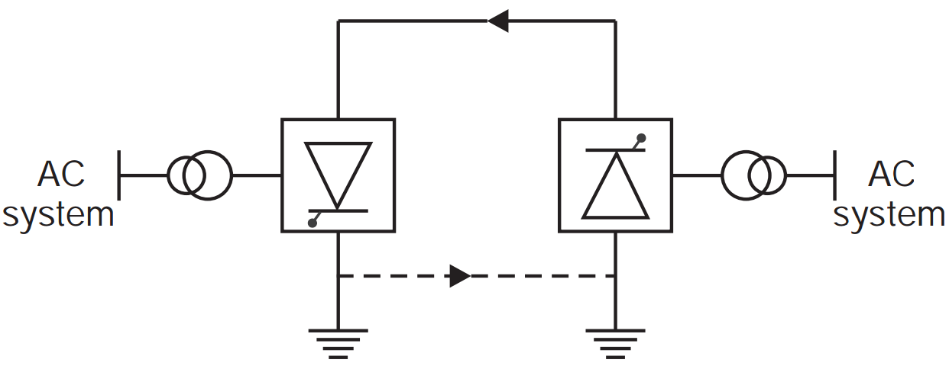
Classification of HVDC transmission system
The classification of HVDC systems depends upon the arrangement of the pole and the earth return. They are as follows: (i) Monopolar link (ii) Bipolar link (iii) Homopolar link
(i)Monipolar Link : A monopolar link has only one conductor, with ground or sea as a return path. Generally, the conductor has a negative polarity with respect to the earth
ADVANTAGES: • The corona effect in a DC line is less because of the negative • Less conductor material is required as ground is used as the return path. • Less insulation cost.

Slide 4
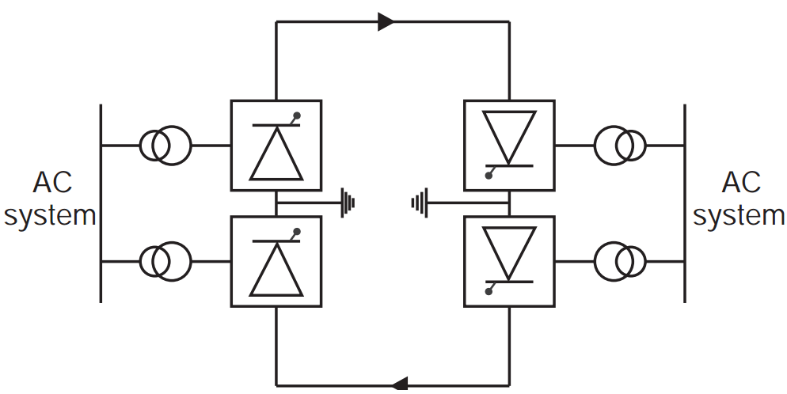
Classification of HVDC transmission system
(ii) Bipolar links: have two conductors, one at the positive potential and the other at the negative (same magnitude) with respect to the ground. At each terminal, two identical sets of converters are connected in series, on the DC side.
Advantages:
• Power transmitting capacity is doubled when compared to monopolar link. • If a fault occurs in one conductor, half power can be transmitted through other
DISADVANTAGES: • Terminal equipment cost is high. • More conductor material is required. • Corona loss is high.

Slide 5
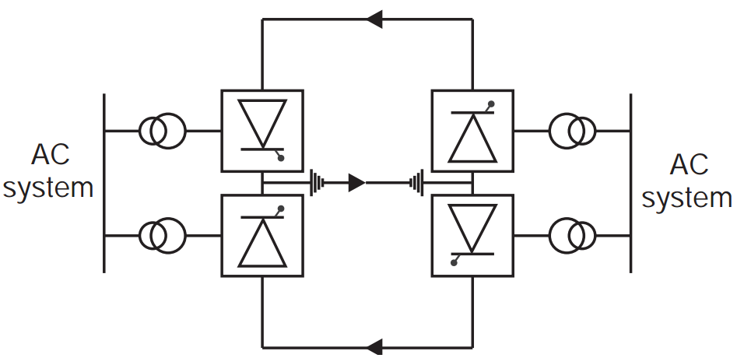
Classification of HVDC transmission system
Homopolar link: has two or more conductors, all having the same polarity, and ground is used as the return path.
ADVANTAGES: • Corona effect is less in negative polarity conductors. • Less conductor material is required because ground is used as the return path. • We can avoid power interruption due to faults by transmitting power through other conductors. • Reliability is high. • Insulation costs are low.
DISADVANTAGES: • Ground return path causes corrosion of buried metallic structures. • Causes disturbance in underground communication cables.

Slide 6
Technical Performance
Between AC and DC transmission which one will we use?
We will decide based on:
(i) Technical Performance and
(ii) Economic consideration.
Interconnection:
AC interconnection: Two AC systems are connected by an AC link. Frequency of these two system should be very close. It is also known as synchronous tie
Disadvantages of AC interconnection:
→ Frequency disturbance in one system is transferred to other system
→ Power swing in one system may affect the other system. Major fault in one system may lead to the complete failure of the system.
→ Increase in fault level.

Slide 7
Technical Performance
Advantages of DC interconnection:
A DC interconnection provides loose tie between two AC system.
→ Can interconnect two AC system of different frequency.
→ Fast and reliable control of magnitude and direction of power flow by controlling firing angle.
02. Stability limit: In AC system
→ Reactance of the line increases with the length of the line
→ It leads the reactive power drop
→ So reactive power to be injected at regular interval to stabilize the AC system
But DC system is free of this limitation due to absence of reactance. Thus power transfer capability is unaffected by the distance.

Slide 8
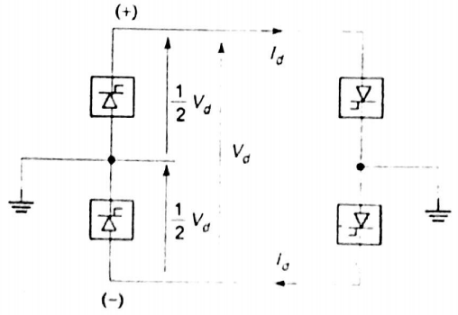
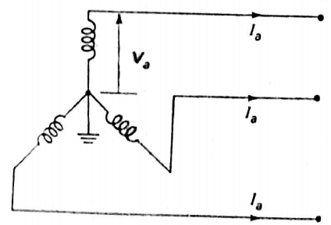
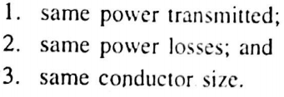
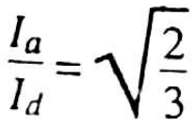
Economic Comparison
01. A new DC line is to be provided instead of 3 phase AC line:
Since two losses are equal:
${{2I}_{d}}^{2}R$ =$3{I_{a}}^{2}R$
Power transmitted by DC = $V_{d}I_{d}$
Power transmitted by AC =$3V_{a}I_{a}\cos{θ}$
Power loss in DC =${{2I}_{d}}^{2}R$
Power transmitted by AC =$3{I_{a}}^{2}R$

Slide 9
Economic Comparison
For same power to be transmitted on both side

Slide 10
Economic Comparison

Slide 11
Economic Comparison
02. Converting a three phase double circuit line to a three circuit DC line
Power transfer in 3 phase double circuit AC line =
Power transfer in 3 circuit DC line =

Slide 12
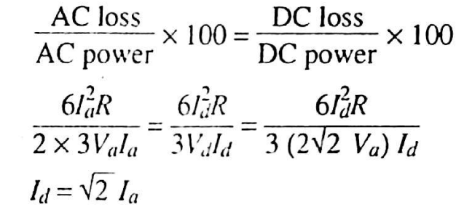
Economic Comparison

Slide 13
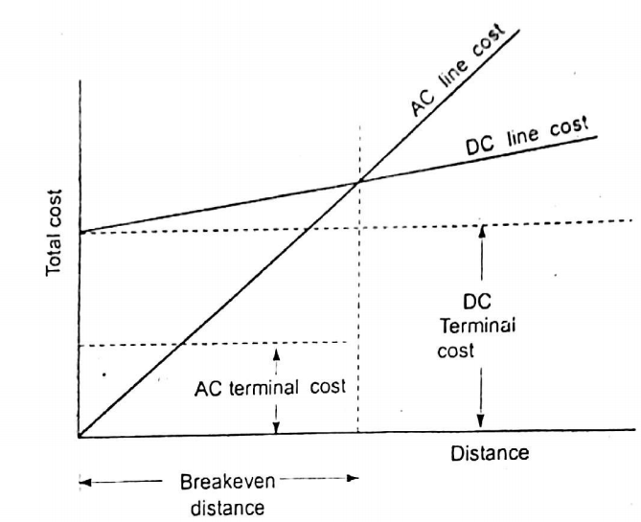
Economic Distance for HVDC transmission system

Slide 14
Advantages of HVDC transmission system:
See page no 616-617 from
Electrical Power system By Ashfaq husain

